Slide 1
Data, Business Intelligence
And Analytics

Slide 2
Organizations are drowning in data…
… but lacking in information / knowledge
Our ability to collect and store data seems to have surpassed our ability to make sense of it!
Important trends:
  Storage capacity continues to rise rapidly
  Cost of storage continues to drop
Credit Histories
Web Click Streams
Activity Records
Purchase Data
ERP Transactions
Customer Profiles
Location Tracking (GPS)

Slide 3
What is Business Intelligence?
A Simple Definition:
  The applications and technologies transforming Business Data into Action
  Fact-based decision making typically involves a subset of the following skills/tools…
    Data querying / SQL
    Database design / data warehousing
    Data mining
    Decision support systems / simulations
    Data visualization / Dashboards
Business intelligence (BI) is a technology-driven process for analyzing data and presenting actionable information to help executives, managers and other corporate end users make informed business decisions.
The analytics give insight on most successful sourcing channels and provide metrics to increase effectiveness, ultimately lowering the cost on the spend.

Slide 4
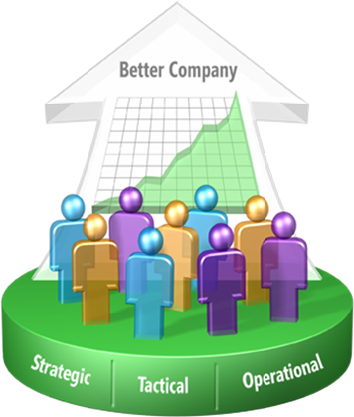
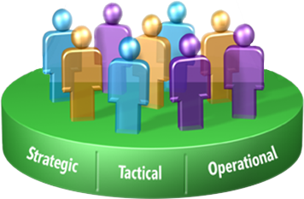
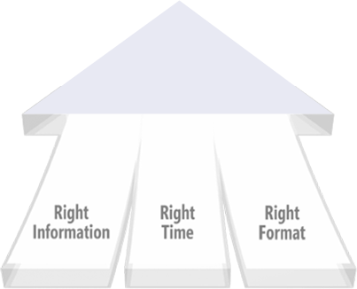
The BI goal
BI is about using data to help enterprise users make better business decisions

Slide 5
Data / Information / Knowledge
Data – a collection of raw value elements or facts used for calculating, reasoning, or measuring.
Information – the result of collecting and organizing data in a way that establishes relationship between data items, which thereby provides context and meaning
Knowledge – the concept of understanding information based on recognized patterns in a way that provides insight to information.

Slide 6
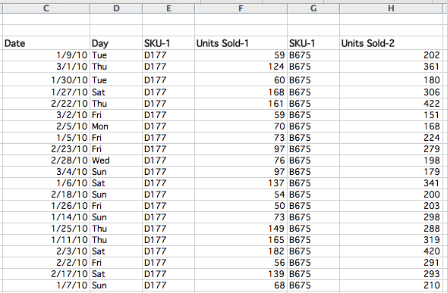
Famous “Beer and Diapers” BI example
Consider the follow convenience-store transactional data (register sales receipts)

Slide 7
Famous “Beer and Diapers” BI example
What did managers learn? That beer & diapers are often bought by men on Thursday and Saturdays. Why?
Data → Information → Knowledge (Insight)

Slide 8
Goal: Convert Data to (Actionable) Knowledge
Knowledge
Info
Increasing
Value
Data
Hard to do in practice – requires commitment/effort.

Slide 9
What is OLAP?
OLAP (Online analytical processing) is a process of performing multidimensional analysis at high speeds on large volumes of data from a data warehouse, data mart, or some other unified, centralized data store.
Online Analytical Processing Server (OLAP) is based on the multidimensional data model. It allows managers, and analysts to get an insight of the information through fast, consistent, and interactive access to information.

Slide 10
OLAP vs. OLTP
Online transaction processing, or OLTP, refers to data-processing methods and software focused on transaction-oriented data and applications.
The main difference between OLAP and OLTP is in the name: OLAP is analytical in nature, and OLTP is transactional.
OLAP tools are designed for multidimensional analysis of data in a data warehouse, which contains both transactional and historical data. In fact, an OLAP server is typically the middle, analytical tier of a data warehousing solution. Common uses of OLAP include data mining and other business intelligence applications, complex analytical calculations, and predictive scenarios, as well as business reporting functions like financial analysis, budgeting, and forecast planning.
OLTP is designed to support transaction-oriented applications by processing recent transactions as quickly and accurately as possible. Common uses of OLTP include ATMs, e-commerce software, credit card payment processing, online bookings, reservation systems, and record-keeping tools.

Slide 11
Data Warehousing - Schemas
Schema is a logical description of the entire database. It includes the name and description of records of all record types including all associate
Types of Data Warehouse Schema:
  Star Schema
  Snowflake Schema
  Starflake Schema

Slide 12
Data Warehousing - Schemas
Star Schema in data warehouse, in which the center of the star can have one fact table and a number of associated dimension tables. It is known as star schema as its structure resembles a star. The Star Schema data model is the simplest type of Data Warehouse schema.
Snowflake Schema in data warehouse is a logical arrangement of tables in a multidimensional database such that the ER diagram resembles a snowflake shape. A Snowflake Schema is an extension of a Star Schema, and it adds additional dimensions.
Starflake Schema is combination of a star schema and snowflake schema is called a Starflake Schema. It is a snowflake schema wherein some of the dimension tables have been unnormalized. It allows more efficient access to the data by various tools, and the ability to adapt to changes in user requirements [2]. It is also extensible, as it supports adding new dimensions.

Slide 13
What Are Facts and Facts Tables?
Fact tables
Fact tables contain the data corresponding to a particular business process. Each row represents a single event associated with a process and contains the measurement data associated with that event. It contains the numeric, quantitative data (aka measures). Typically one fact table per distinct business process. Exception: “consolidated” facts (aka “merged” facts) such as actual vs. forecast which require the same granularity and are frequently analyzed together.
Dimensions
Dimension describe the objects involved in a business intelligence effort. While facts correspond to events, dimensions correspond to people, items, or other objects.
Dimension tables: provide the descriptive context – attributes with the who, what, when, why, or how. They should always include friendly names & descriptions.

Slide 14
What is ETL?
ETL is a process which is use for data extraction from the source (database, XML file, text files, etc.). Transforms the data and then loads the data into the data warehouse.
ETL can be termed as Extract Transform Load. ETL extracts the data from a different source (it can be an oracle database, xml file, text file, xml, etc.).Then transforms the data (by applying aggregate function, keys, joins, etc.) using the ETL tool and finally loads the data into the data warehouse for analytics.
ETL has three main processes:
Extraction
Transform
Load

Slide 15
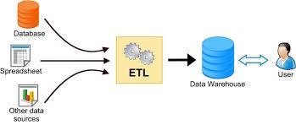
ETL
ETL stands for Extraction Transform and Load.

Slide 16
Extraction
Extraction generally starts with the Extraction of data from various heterogeneous sources that might be some flat files(csv, txt or etc), EXCEL spreadsheet, API based system or may be various other databases they might be in some operation system(OLTP).
Above mention data (flat files or spreadsheets) can be made available through the FTP or S3 buckets with their control total file.
Control total file is file that contains the header information of data with the counts and other basic information that can be used to check the consistency of data after extraction from source to destination.

Slide 17
Extraction Contd..
There might be different strategies on Data extraction
  Full Extraction (Refresh)
  Partial Extraction (Append)
  If the extraction is FULL, first the last load data will taken as backup and new set of data will be loaded in the staging and delta will be calculated based on new data load and existing data.
  If the extraction is Partial, it will be added to the existing data and filter out the duplicate data as well as update the existing data if it is updated with the new record.
After data is extracted from the source and loaded in staging server data load verification is done using the control total file that comes along with data files.
The last step of Extraction will be data profiling.

Slide 18
Transformation
Transformation step consist of data integration, data cleansing, mapping and data transformation.
Data that are extracted from source system are raw and that cannot be used as it is hence it should be standardized as needed, there might be data transformation done as per the business requirement or definition can be added and data integration will be done.
Transformation doesn't mean addition or deleting the data but it is transformation from one form to another with out loosing its meaning.

Slide 19
Transformation Contd..
Some Transformation tasks:
  Data Integration: In this step data from different sources are integrated.
  Selection : It is the processing of selecting the only those column which actually needed or required by output system.
  Matching : In this step we match the raw data with the lookup or master data that needed to be transformed.
  Data Cleansing: This process standardizes various data in the companies based on the specific rule and adjusts them to be used easily for new services and applications. It is the task which must be especially done when data is migrated from the mainframe and system is changed from legacy to new one.

Slide 20
Transformation Contd..
Major Transformation types:
  Data standardizing: As data are fetched from different sources hence they may not be in the same format thus data standardizing is done.
  Calculated and derived data: In this step different new column may be derived from source columns as per the business requirement.
  Splitting and Merging : As per the business requirement we have to split some column in different column or may be merge into single column depending upon business requirement.
  Conversion of unit of measurement : In this step source data are converted in uniform unit of measurement.
  Deduplication : In this step duplicate data will be removed that we can get from source system.

Slide 21
Loading
Data Loading is the process of loading the data in warehouse or database that are prepared after applying the Transformation logic.

Slide 22
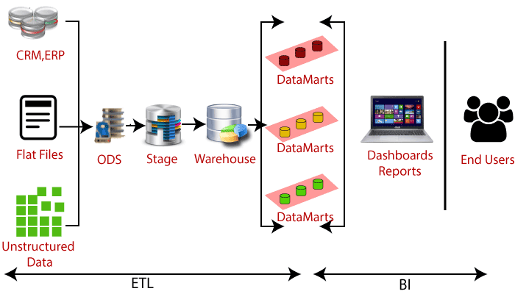
ETL Architecture

Slide 23
Need of ETL
ETL is a tool that extracts, transform, and load raw data into the user data.
ETL helps firms to examine their business data to make critical business decisions.
It provides a technique of transferring the data from multiple sources to a data warehouse.
Transactional databases do not answer complicated business questions, but ETL can be able to answer this question.
ETL is a pre-set process for accessing and refining data source into a piece of useful data.
When the data source changes, the data warehouse will be updated.
Properly designed and validated ETL software is essential for successful data warehouse management.
It helps to improve productivity because it is simplified and can be used without the need for technical skills.

Slide 24
ETL Tools
Informatica PowerCenter
Oracle Data Integrator (ODI)
Pentaho Data Integration (PDI)
SQL Server Integration Services (SSIS)
Cognos Data Manager
QlikView Expressor
SAP Data Services
Talend Open Studio & Integration Suite
IBM Information Server (DataStage)
etc

Slide 25
ETL Pipelining Tools
Amazon Glue
Microsoft Flow
Air Flow
Etc.

